Slide 1
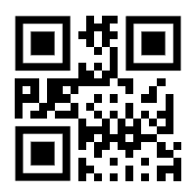
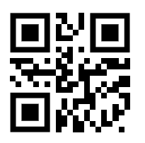
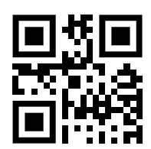
QR Code Samples
RED
GREEN
BLUE

Slide 2
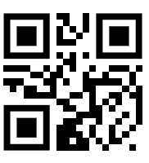
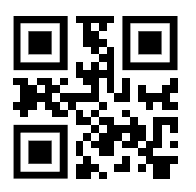
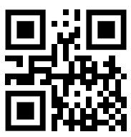
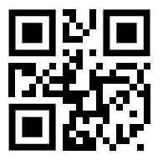
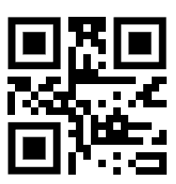
QR Code Samples
LIGHT SHOW 0
(orangish)
LIGHT SHOW 1
(greenish)
LIGHT SHOW 2
(blueish)
LIGHT SHOW 3
(yellowish)
LIGHT SHOW 4
(pinkish)

